Slide 1
CHAPTER 1 BASIC CONCEPT
All the programs in this file are selected from
Ellis Horowitz, Sartaj Sahni, and Susan Anderson-Freed
“Fundamentals of Data Structures in C”,

Slide 2
Data Type
Data Type A data type is a collection of objects and a set of operations that act on those objects.
Predefined objects: int, float, double, char, … in C
Operation: + - * / %...
All programming language provide at least a minimal set of predefined data types, plus the ability to construct new, or user-defined data types.
struct in C
int a = 1, b = 2, c;
c = a + b;
float a = 1.0, b = 2.0
float c;
c = a + b;
struct student {
char lastname;
int studentId;
char grade;
}

Slide 3
Data Abstraction
Hiding the representation of objects of a data type from its users is a good design strategy.
Abstract Data Type An abstract data type(ADT) is a data type that is organized in such a way that the specification of the objects and the operations on the objects is separated from the representation of the objects and the implementation of the operations.
e.g., package in Ada and class in C++
Although C does not have explicit mechanism for implementing ADTs, it is still possible to design your data types using the same notion.

Slide 4
Specification vs. Implementation
Operation specification
function name
the types of arguments
the type of the results
Implementation independent
Function Types
Creator/Constructor: create a new instance
Transformer: create an instance by existing instances
Observer/Reporter: provide information without changing

Slide 5
*Structure 1.1:Abstract data type Natural_Number (p.20) structure Natural_Number is objects: an ordered subrange of the integers starting at zero and ending at the maximum integer (INT_MAX) on the computer functions: for all x, y ∈ Nat_Number; TRUE, FALSE ∈ Boolean and where +, -, <, and == are the usual integer operations. Nat_No Zero ( ) ::= 0 Boolean Is_Zero(x) ::= if (x) return FALSE else return TRUE Boolean Equal(x,y) ::= if (x== y) return TRUE else return FALSE Nat_No Successor(x) ::= if (x == INT_MAX) return x else return x+1 Nat_No Add(x, y) ::= if ((x+y) <= INT_MAX) return x+y else return INT_MAX Nat_No Subtract(x,y) ::= if (x<y) return 0 else return x-y end Natural_Number
::= is defined as

Slide 7
Algorithm
Definition An algorithm is a finite set of instructions that accomplishes a particular task.
Criteria
input
output
definiteness: clear and unambiguous instructions
finiteness: terminate after a finite number of steps
effectiveness: instruction is basic enough to be carried out

Slide 8
*Program 1.11: Iterative function for summing a list of numbers (p.24) float sum (float list[ ], int n) { float tempsum = 0; int i; for (i = 0; i<n; i++) tempsum += list [i]; return tempsum; }
Summing a list of numbers
Input: list and number of items
Output: sum of numbers
Notes:
如果你覺得 program 1.11 很難，那你應該先不要修資料結構

Slide 9
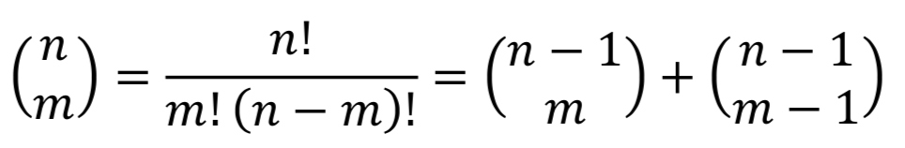
Recursive Algorithms
Recursion:
A function call itself (direct recursion)
A function call other functions that invoke the calling again (indirect recursion)
Any function that we can write using assignment, if-else, and while statement can be written recursively
Recursive function allows us to express an complex process in very clear terms

Slide 10
*Program 1.11: Iterative function for summing a list of numbers (p.24) float sum (float list[ ], int n) { float tempsum = 0; int i; for (i = 0; i<n; i++) tempsum += list [i]; return tempsum; }
sum (list, n) = sum(list, n-1) + list[n-1]
sum (list, 0) = 0
*Program 1.12: Recursive function for summing a list of numbers (p.24) float rsum(float list[ ], int n) { if (n) return rsum(list, n-1) + list[n-1]; return 0; // boundary condition }

Slide 11
Recursion for n Factorial
Recursive function for n-factorial:
n!
f(n) = n * f(n-1), if n > 1
f(n) = 1, if n = 0
Write the iterative version and recursive version
Similar to induction
n = 1
n = k ➔ reuse the smaller cases (n<k)

Slide 13
Binary Search
Give a sorted list, the problem asks whether the searchnum is in the list.
e.g., searchnum = 6
6 < 7
1 | 3 | 4 | 6 | 7 | 8 | 10 | 13 | 14
L = 0
M = 4
R = 9
6 > 3
1 | 3 | 4 | 6 | 7 | 8 | 10 | 13 | 14
L = 0
M = 1
R = 3
6 > 4
1 | 3 | 4 | 6 | 7 | 8 | 10 | 13 | 14
L = M = 2
R = 3
Found 6
1 | 3 | 4 | 6 | 7 | 8 | 10 | 13 | 14
L = M = R= 3

Slide 14
*Program 1.5: Searching in an sorted list (p.12) while (there are more integers to check) { middle = (left + right) / 2 ; if (searchnum > list[middle]) left = middle + 1 ; else if (searchnum < list[middle]) right = middle - 1; else return middle; } Not found;
Iterative Pseudocode for Binary Search

Slide 15
*Program 1.7: searching an ordered list (p.13) void binarysearch (int list[ ], int searchnum, int left, int right) { /* search list [0] <= list [1] <= … <= list [n-1] for searchnum. Return its position if found. Otherwise return -1 */ int middle; while (left <= right) { middle = (left + right) / 2 ; switch ( COMPARE (list [middle], searchnum) ) { case -1: left = middle + 1; break; case 0: return middle; case 1: right = middle - 1; } } return -1; }
// COMPARE (a, b) returns -1 if a < b; returns 0 if a = b; otherwise, return 1

Slide 16
*Program 1.8: Recursive implementation of binary search (p.15) void binarysearch (int list[ ], int searchnum, int left, int right) { /* search list [0] <= list [1] <= … <= list [n-1] for searchnum. Return its position if found. Otherwise return -1 */ int middle; if (left <= right) { middle = (left + right) / 2 ; switch ( COMPARE (list [middle], searchnum) ) { case -1: return binarysearch(list, searchnum, middle+1, right); case 0: return middle; case 1: return binarysearch(list, searchnum, left, middle-1); } } return -1; }

Slide 17
Implementation issue
Be aware of the representation of object:
middle = (left + right) / 2 ;
Recall the representation of integers in CPU
e.g., 8-bit unsigned integer left = 127, right = 255 what will happen?
It will cause overflow
To prevent overflow:
middle = left + (right - left) / 2

Slide 19
Example: find all the possible permutations of set (a, b, c) a followed by all permutation of (b, c) b followed by all permutation of (a, c) c followed by all permutation of (a, b)
Permutations
Given a set, the problem asks all the possible permutations of this set.

Slide 20
*Program 1.9: Recursive permutation generator (p.16) void perm (char *list, int i, int n) { /* generate all the permutations of list[i] to list[n] */ int j, temp; if (i == n) { for ( j = 0; j <= n ; j ++) printf ( “%c”, list[j] ); printf (“\n”); } else { /* if list[i] to list[n] has more than one permutation, generate these recursively */ for ( j = i ; j < n ; j ++ ) { SWAP (list[i], list[j], temp); perm (list, i + 1, n ); SWAP (list[i], list[j], temp); } } }

Slide 22
Measurements
Criteria
Is it correct?
Is it readable?
…
Performance Measurement (machine dependent)
Is the running time acceptable?
Performance Analysis (machine independent)
space complexity: storage requirement
time complexity: computing time

Slide 23
Space Complexity S(P)=C+S_{P}(I)
Fixed Space Requirements (C) Independent of the characteristics of the inputs and outputs
instruction space (that stores the code)
space for simple variables, fixed-size structured variable, constants
Variable Space Requirements (S_{P}(I)) depend on the characteristic of instance I
number, size, values of inputs and outputs associated with I
recursive stack space, formal parameters, local variables, return address

Slide 24
*Program 1.10: Simple arithmetic function (p.23) float abc (float a, float b, float c) { return a + b + b * c + (a + b - c) / (a + b) + 4.00; } *Program 1.11: Iterative function for summing a list of numbers (p.24) float sum (float list[ ], int n) { float tempsum = 0; int i; for (i = 0; i<n; i++) tempsum += list [i]; return tempsum; }
S_{abc}(I) = 0
S_{sum}(I) = 0
C does not copy the array
Recall: pass the address of the
first element of the array &
pass by value

Slide 25
int* sum (int n) { int *list = malloc(sizeof(int), n); int i; for (i = 0; i<n; i++) list = i; return list; }
*Program 1.11: Iterative function for summing a list of numbers (p.24) float sum (float list[ ], int n) { float tempsum = 0; int i; for (i = 0; i<n; i++) tempsum += list [i]; return tempsum; }
S_{sum}(I) = 0
S_{sum}(I) = 4n

Slide 26
*Program 1.12: Recursive function for summing a list of numbers (p.24) float rsum(float list[ ], int n) { if (n) return rsum(list, n-1) + list[n-1]; return 0; } *Figure 1.1: Space needed for one recursive call of Program 1.12 (p.25)
S_{sum}(I)=S_{sum}(n)=12n
Assumptions:

Slide 27
Time Complexity
T(P)=C+T_{P}(I)
Compile time (C) independent of instance characteristics
run (execution) time T_{P}
Definition A program step is a syntactically or semantically meaningful program segment whose execution time is independent of the instance characteristics.
Example
abc = a + b + b * c + (a + b - c) / (a + b) + 4.0
abc = a + b + c
T_{P} (n)=c_{a} ADD(n)+c_{s} SUB(n)+c_{l} LDA(n)+c_{st} STA(n)
Regard as the same unit
machine independent

Slide 28
Methods to compute the step count
Introduce variable count into programs
Tabular method
Determine the total number of steps contributed by each statement step per execution × frequency
add up the contribution of all statements

Slide 29
*Program 1.13: Program 1.11 with count statements (p.26) float sum (float list[ ], int n) { float tempsum = 0; int i; for (i = 0; i < n; i++) { tempsum += list[i]; } return tempsum; }
Iterative summing of a list of numbers

Slide 30
*Program 1.13: Program 1.11 with count statements (p.26) float sum (float list[ ], int n) { float tempsum = 0; count++; /* for assignment */ int i; for (i = 0; i < n; i++) { count++; /*for the for loop */ tempsum += list[i]; count++; /* for assignment */ } count++; /* last execution of for */ count++; /* for return */ return tempsum; }
Iterative summing of a list of numbers
2n + 3 steps

Slide 31
*Figure 1.2: Step count table for Program 1.11 (p.30)
Tabular Method
Iterative function to sum a list of numbers
steps/execution

Slide 32
*Program 1.13: Simplified version of Program 1.12 (p.23) float sum(float list[ ], int n) { float tempsum = 0; int i; for (i = 0; i < n; i++) count += 2; count += 3; return 0; }
2n + 3 steps

Slide 33
*Program 1.15: Program 1.12 with count statements added (p.27) float rsum (float list[ ], int n) { count++; /*for if conditional */ if (n) { count++; /* for return and rsum invocation */ return rsum(list, n-1) + list[n-1]; } count++; return 0; }
Recursive summing of a list of numbers
2n+2 steps

Slide 34
*Figure 1.3: Step count table for recursive summing function (p.32)
Recursive Function to sum of a list of numbers
Recursive version has fewer steps!? Is it faster than iterative version?
Notes:
其實就是了一個 tempsum 的宣告

Slide 35
*Program 1.16: Matrix addition (p.28) void add ( int a[ ] [MAX_SIZE], int b[ ] [MAX_SIZE], int c [ ] [MAX_SIZE], int rows, int cols) { int i, j; for (i = 0; i < rows; i++) for (j= 0; j < cols; j++) c[i][j] = a[i][j] +b[i][j]; }
Matrix addition

Slide 36
*Program 1.17: Matrix addition with count statements (p.29) void add (int a[ ][MAX_SIZE], int b[ ][MAX_SIZE], int c[ ][MAX_SIZE], int row, int cols ) { int i, j; for (i = 0; i < rows; i++){ count++; /* for i for loop */ for (j = 0; j < cols; j++) { count++; /* for j for loop */ c[i][j] = a[i][j] + b[i][j]; count++; /* for assignment statement */ } count++; /* last time of j for loop */ } count++; /* last time of i for loop */ }
2rows * cols + 2 rows + 1

Slide 37
*Figure 1.4: Step count table for matrix addition (p. 31)
Matrix Addition
Suggestion: Interchange the loops when rows >> cols

Slide 38
Evaluation of Complexity
Time complexity is not always nice functions of fairly simple characteristics like the number of elements
Example: binary search on a sorted list
May range from 1 to log n
Remedy
Worst case, best case, and average case

Slide 39
Comparison of Complexity
Complexity of c₁n²+c₂n and c₃n
for sufficiently large of value, c₃n is faster than c₁n²+c₂n
for small values of n, either could be faster
c₁=1, c₂=2, c₃=100 --> c₁n²+c₂n ≤ c₃n for n ≤ 98
c₁=1, c₂=2, c₃=1000 --> c₁n²+c₂n ≤ c₃n for n ≤ 998
break even point
no matter what the values of c1, c2, and c3, the n beyond which c₃n is always faster than c₁n²+c₂n

Slide 40
Asymptotic Notation (O)
Definition [Big “oh”] f (n) = O(g (n)) iff there exist positive constants c and n₀ such that f (n) ≤ cg (n) for all n, n ≥ n₀.
Examples
3n+2=O(n) /* 3n+2≤4n for n≥2 */
3n+3=O(n) /* 3n+3≤4n for n≥3 */
100n+6=O(n) /* 100n+6≤101n for n≥10 */
10n²+4n+2=O(n²) /* 10n²+4n+2≤11n² for n≥5 */
6*2^{n}+n²=O(2^{n}) /* 6*2^{n}+n² ≤7*2^{n} for n≥4 */

Slide 41
*Figure 1.5: Time Complexity of Matrix Addtion (p. 38)
Example: Matrix Addition

Slide 42
Selection Sort
Hypothesis: we know how to sort k-1 elements
Induction on a special k-th element
Given sorted k-1 elements
Select the minimal element from unsorted as the n-th element by scanning the n-(k-1) sorted elements
Put in correct place by swapping
1
2
…
k-1
k
…
n
 |  | min
Sorted
Unsorted

Slide 43
Selection Sort
Initial | 26 | 5 | 77 | 1 | 61 | 11 | 59 | 15 | 48 | 19
Step 1 | 1 | 5 | 77 | 26 | 61 | 11 | 59 | 15 | 48 | 19
Step 2 | 1 | 5 | 77 | 26 | 61 | 11 | 59 | 15 | 48 | 19
Step 3 | 1 | 5 | 11 | 26 | 61 | 77 | 59 | 15 | 48 | 19
Step 4 | 1 | 5 | 11 | 15 | 61 | 77 | 59 | 26 | 48 | 19
Step 5 | 1 | 5 | 11 | 15 | 19 | 77 | 59 | 26 | 48 | 61
Step 6 | 1 | 5 | 11 | 15 | 19 | 26 | 59 | 77 | 48 | 61
Step 7 | 1 | 5 | 11 | 15 | 19 | 26 | 48 | 77 | 59 | 61
Step 8 | 1 | 5 | 11 | 15 | 19 | 26 | 48 | 59 | 77 | 61
Step 9 | 1 | 5 | 11 | 15 | 19 | 26 | 48 | 59 | 61 | 77

Slide 44
*Program 1.4: Selection sort (p.11) void sort (int list[ ], int n) { int i, j, min, temp; for (i = 0; i < n-1; i++) { min = i; for (j = i+1; j < n; j++) if (list[j] < list[min]) min = j; SWAP ( list [i] , list [min], temp ); } }
Selection Sort
O( n )
O( n )
O( n * n )
O( n * n )
O( n * n )
O( n )
O(n²)

Slide 45
*Program 1.7: searching an ordered list (p.13) void binarysearch (int list[ ], int searchnum, int left, int right) { /* search list [0] <= list [1] <= … <= list [n-1] for searchnum. Return its position if found. Otherwise return -1 */ int middle; while (left <= right) { middle = (left + right) / 2 ; switch ( COMPARE (list [middle], searchnum) ) { case -1: left = middle + 1; break; case 0: return middle; case 1: right = middle - 1; } } return -1; }
Binary Seraching in Ordered List
O(log n)

Slide 46
*Program 1.9: Recursive permutation generator (p.16) void perm (char *list, int i, int n) { /* generate all the permutations of list[i] to list[n] */ int j, temp; if (i == n) { for ( j = 0; j <= n ; j ++) printf ( “%c”, list[j] ); printf (“\n”); } else { /* if list[i] to list[n] has more than one permutation, generate these recursively */ for ( j = i ; j <= n ; j ++ ) { SWAP (list[i], list[j], temp); perm (list, i + 1, n ); SWAP (list[i], list[j], temp); } } }
Permutations
O(n)
O(n!)
Notes:
O ( n! * n )

Slide 47
O(1): constant
O(n): linear
O(n²): quadratic
O(n³): cubic
O(2^{n}): exponential
O(log n): logarithmic
O(n log n)

Slide 48
Asymptotic Notation (Ω)
Definition [Omega] f (n) = Ω(g (n)) iff there exist positive constants c and n₀ such that f (n) ≥ cg (n) for all n, n ≥ n₀.
Examples
3n+2=Ω(n) /* 3n+2≥3n for n≥1 */
3n+3=Ω(n) /* 3n+3≥3n for n≥1 */
100n+6=Ω(n) /* 100n+6≥100n for n≥1 */
10n²+4n+2=Ω(n²) /* 10n²+4n+2≥10n² for n≥1 */
6*2^{n}+n²=Ω(2^{n}) /* 6*2^{n}+n²≥6*2^{n} for n≥1 */

Slide 49
Asymptotic Notation (Θ)
Definition [Theta] f (n) = Θ(g (n)) iff there exist positive constants c₁ and c₂, and n₀ such that c₁g (n) ≤ f (n) ≤ c₂g (n) for all n, n ≥ n₀.
Examples
3n+2=Θ(n)
3n+3=Θ(n)
100n+6=Θ(n)
10n²+4n+2=Θ(n²)
6*2^{n}+n²=Θ(2^{n})

Slide 50
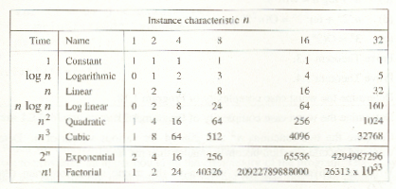
*Figure: Function values

Slide 51
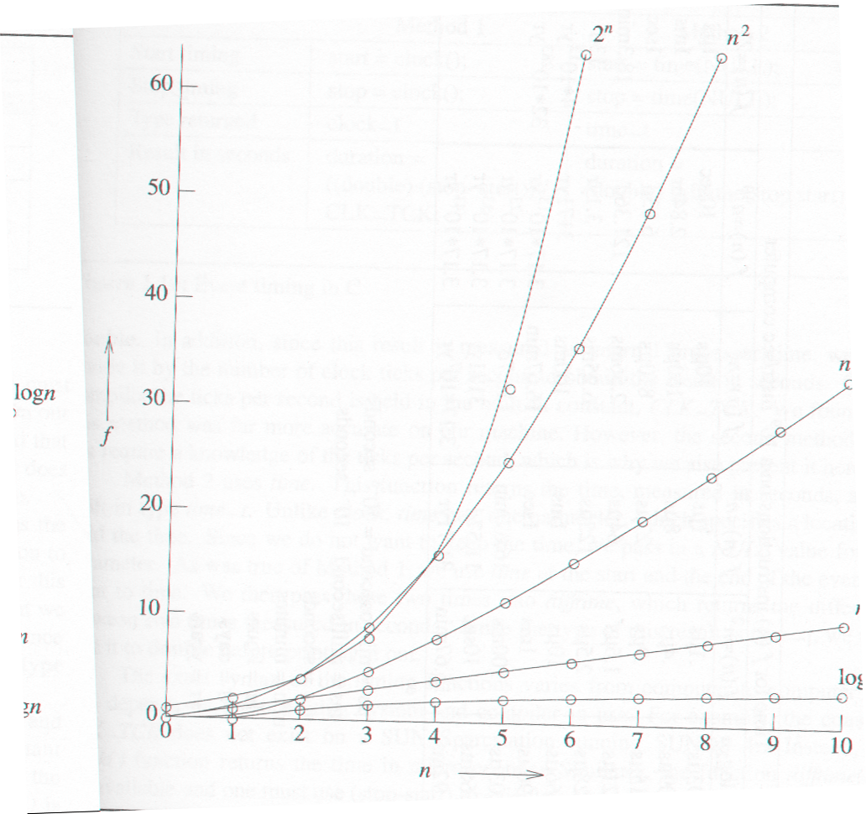
*Figure 1.8: Plot of function values (p.43)
nlogn
n
logn

Slide 52
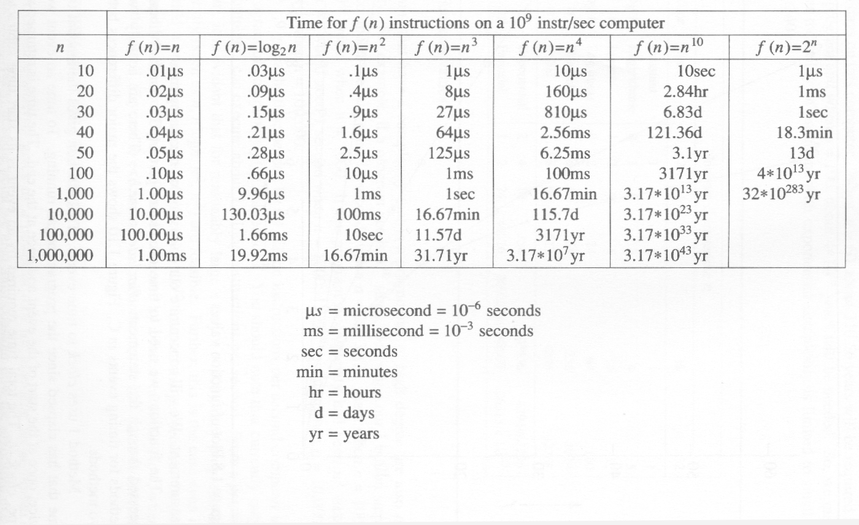
*Figure 1.9: Times on a 1 billion instruction per second computer (p.44)

